Slide 1
HR ANALYTICS DASHBOARD
Stakeholder Presentation — Workforce Insights & Business Intelligence
447
AED 23.67K
3
18
Total Employees
Avg Salary
Avg Performance Rating
Avg Leave Days
Data Analyst: Buruhani Mutebi | UAE Workforce Analytics | 2026

Slide 2
AGENDA
01
Headcount by Department & Branch City
02
Highest Average Salaries by Department
03
New Hire Trends
04
Leave Days vs. Performance Ratings
05
Contract Employee Concentration by Branch
06
Salary Distribution by Nationality & Job Title
07
Key Takeaways & Recommendations
Buruhani Mutebi | HR Analytics 2026

Slide 3
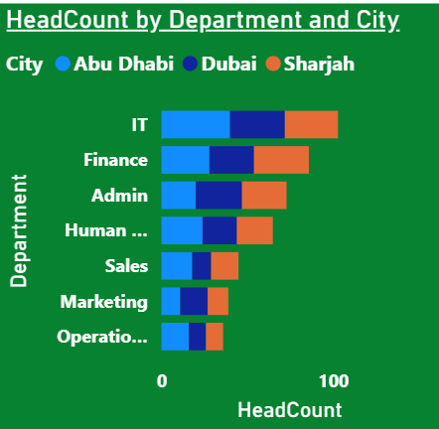
Q1 | Headcount by Department & Branch City
Key Insight IT is the largest dept (103 employees). All 3 cities are evenly distributed (~33% each), indicating balanced geographic spread.

Slide 4
Q2 | Highest Average Salaries by Department
Highest Dept
Sales
AED 25,025 avg
Overall Avg
AED 23.67K
Across all depts
Salary Range
AED 2,151
Sales vs IT gap
Buruhani Mutebi | HR Analytics 2026

Slide 5
Q3 | New Hire Trends
2023
75 Baseline year
2024
148 +97% growth
2025
151 Peak hiring
2026*
73 H1 only (partial)
* 2026 data covers Jan–May only
Buruhani Mutebi | HR Analytics 2026

Slide 6
Q4 | Leave Days Taken vs. Performance Rating
FINDING
● Employees with 31+ leave days show the HIGHEST avg performance (3.16).
● Those taking 16–30 days show the LOWEST rating (2.95).
● Differences are narrow (range: 0.21), suggesting leave alone doesn't drive performance.
● Recommend deeper analysis combining performance type and department.
Buruhani Mutebi | HR Analytics 2026

Slide 7
Q5 | Contract Employee Concentration by Branch
Sharjah 29.1% Contract | Highest
Abu Dhabi 22.9% Contract | Second
Dubai 22.5% Contract | Lowest
Sharjah leads contract hiring — may indicate flexible staffing strategy or project-based work concentration.
Buruhani Mutebi | HR Analytics 2026

Slide 8
Q6 | Salary Distribution: Nationality & Job Titles
Top Paying Job Titles: Data Analyst(AED 26353 ·avg) • Senior Accountant(AED 25272.Avg) • IT(AED25101.Avg)
Buruhani Mutebi | HR Analytics 2026

Slide 9
KEY TAKEAWAYS & RECOMMENDATIONS
1
IT Dept Dominance
4
Leave ≠ Performance Drop
IT has the most staff (103). Consider if this aligns with strategic priorities vs. leaner depts like Operations (36).
Adequate leave (31+ days) is associated with slightly higher performance — supports healthy leave policies.
2
Salary Equity Review
5
Sharjah Contract Reliance
Sales earns 9% more than IT despite IT being largest. A compensation benchmarking review is recommended.
29.1% contract workforce in Sharjah suggests flexibility — review for compliance and benefits equity.
3
Hiring Peaked in 2024–25
6
Nationality Wage Gaps
Growth doubled from 2023 to 2024. Sustaining this in 2026 requires proactive talent pipeline management.
AED 3,798 gap between Lebanese and UAE nationals. Conduct pay equity audit across nationalities.
Buruhani Mutebi | HR Analytics 2026

Slide 10
THANK YOU
Questions & Discussion Welcome
Data Analyst: Buruhani Mutebi Dataset: HR Dataset — UAE Workforce (447 Records, 2023–2026) Scope: 3 Branch Cities · 7 Departments

